Slide 1
Social Medial Analytics
Facebook and Google adds Performance
Date: 28th-Jun-2025
Prepared by: Pratiksha Pawar

Slide 2

Introduction
This presentation analyzes the performance of advertising campaigns run on Facebook and Google.
The evaluation is based on key advertising metrics extracted from visual dashboards.
The focus is on understanding platform-specific strengths, optimization opportunities, and return on investment indicators.

Slide 3
Objective
To evaluate the performance of each platform independently using measurable campaign metrics.
To identify key patterns and trends in campaign behavior over time.
To assist in strategic decision-making through actionable insights and summary recommendations.

Slide 4

FACEBOOK

Slide 5
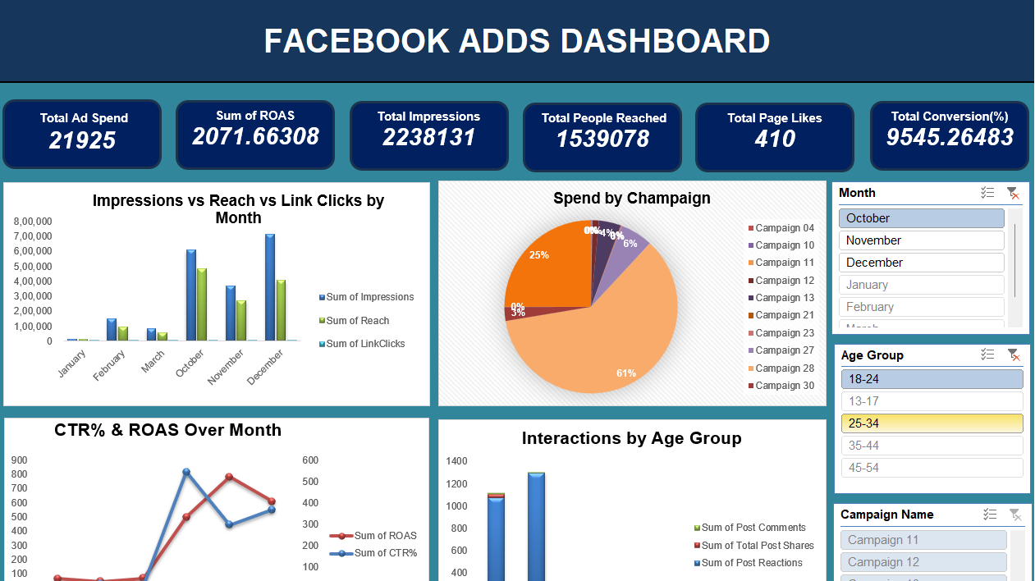

Slide 6
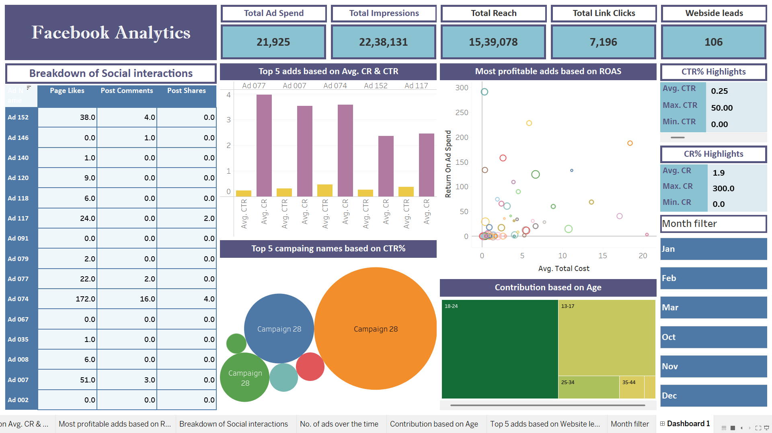

Slide 7
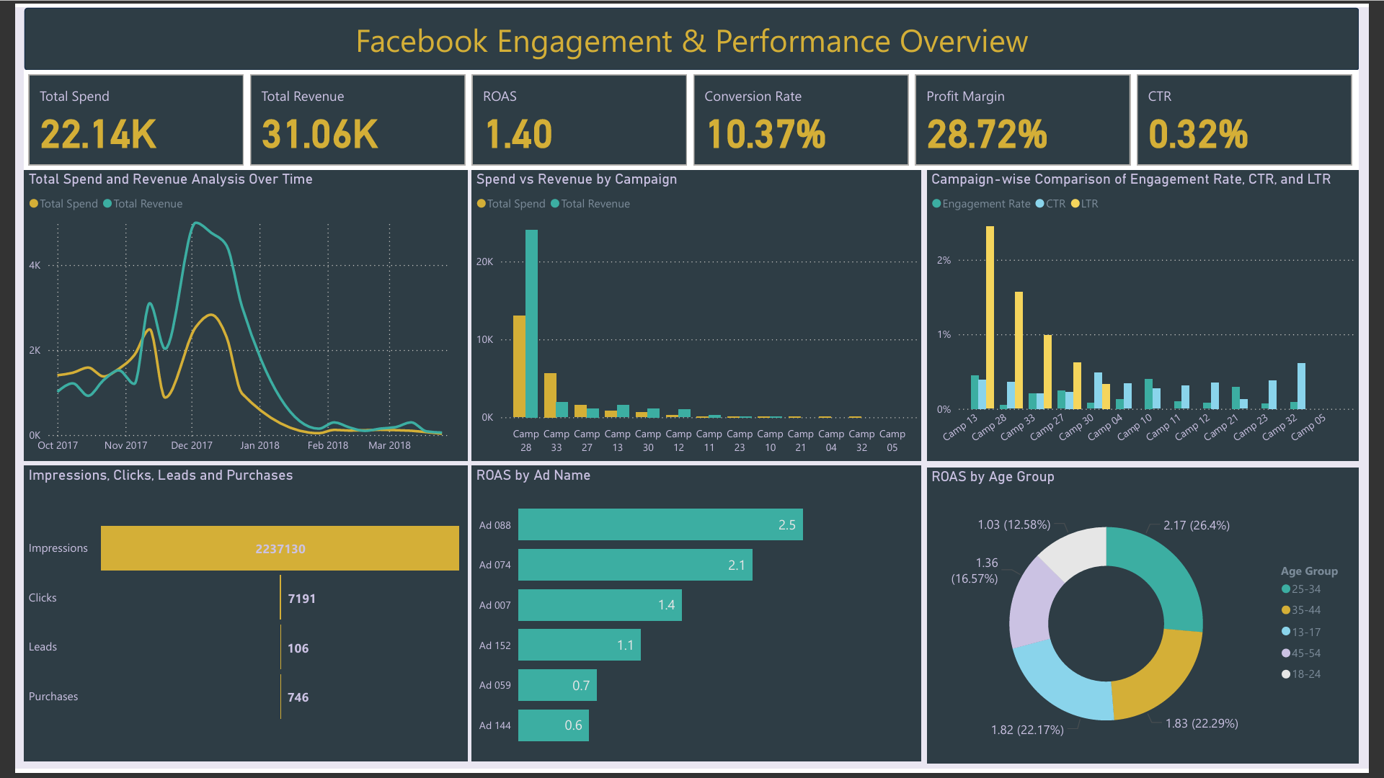

Slide 8
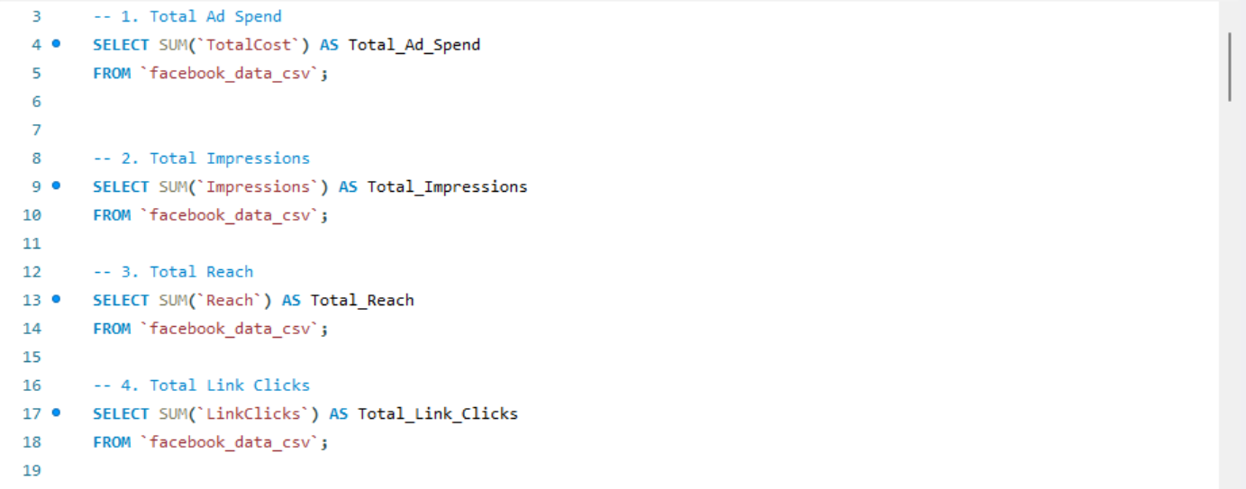
MySQL QnA for Facebook Analytics KPIs

Slide 9
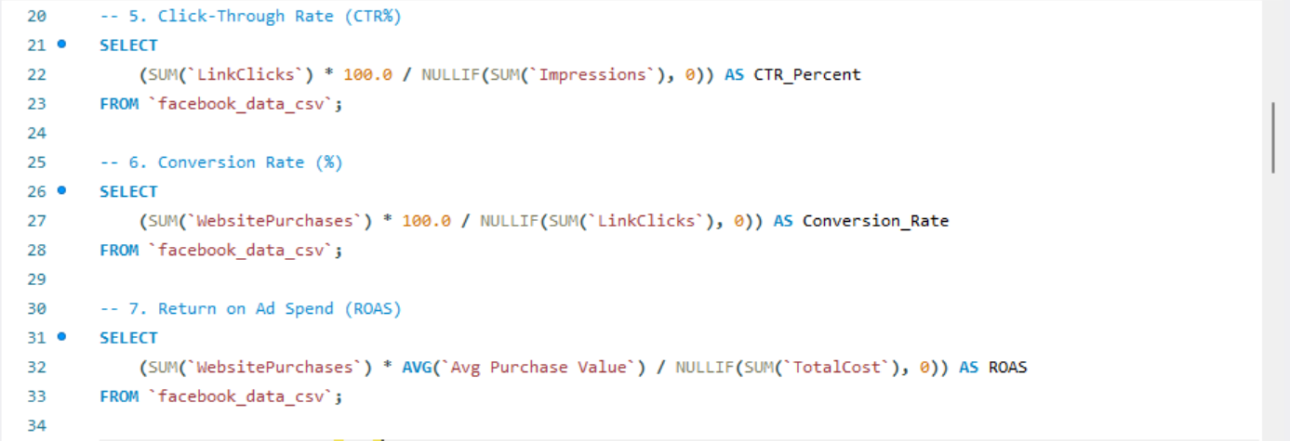

Slide 10
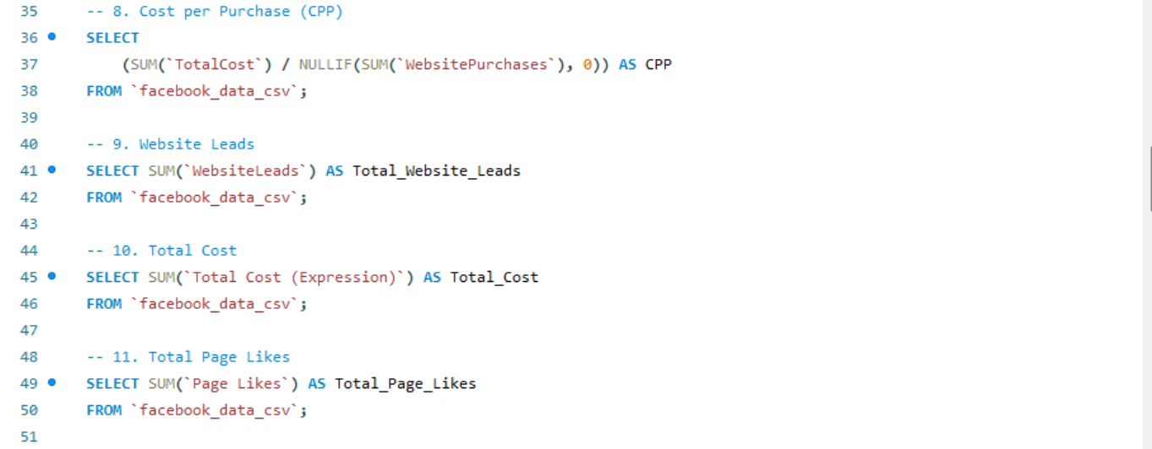

Slide 11
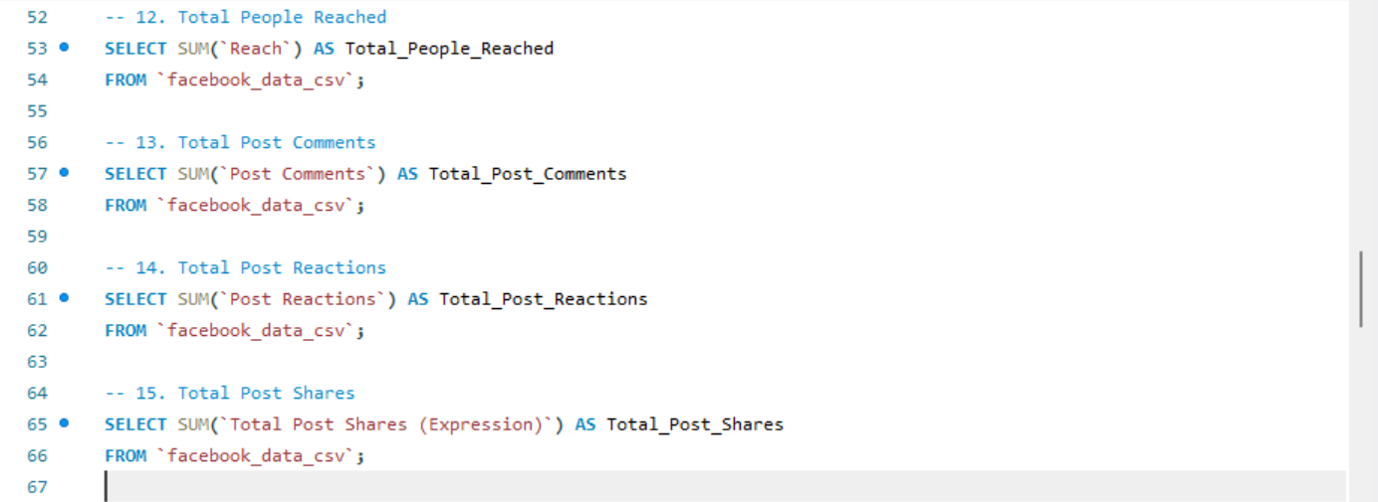

Slide 12
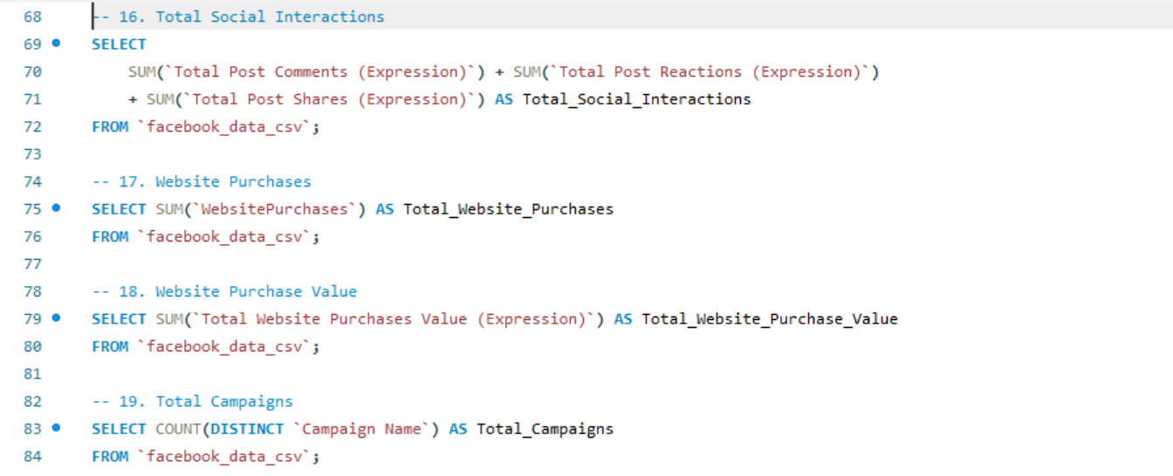

Slide 13
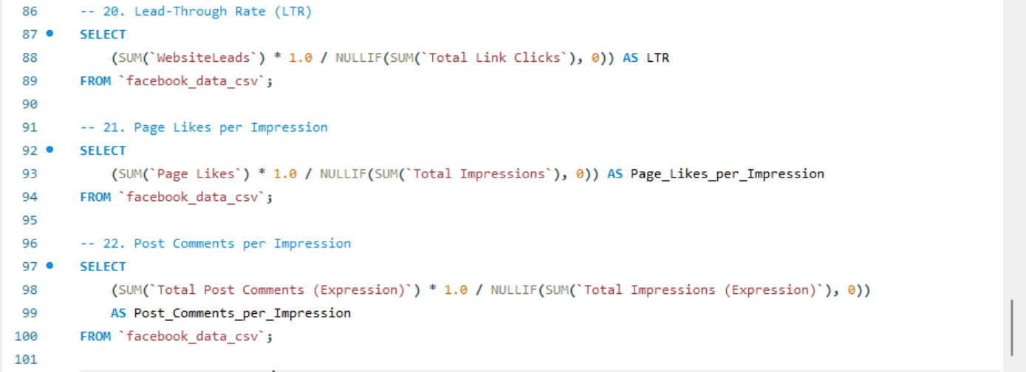

Slide 14
Facebook – Data Insights
Total Spend: Around ₹22,000 across campaigns.
Impressions: Over 2.2 million views (Tableau & Excel).
Clicks: About 7,196 clicks. CTR around 0.25–0.32%.
Conversions: 106 leads in Tableau; up to 746 purchases in Power BI.
Conversion Rate: Ranged from 1.9% to 10.4% depending on ad.
ROAS: About 1.40 (Power BI); lower in most others.
Profit Margin: 28.72% (Power BI).

Slide 15

More Insights
Age
Best Age Group: 18–24 years showed the highest engagement and revenue share.
Campaign
Campaign Strength: Custom audience and retargeting ads had better conversions.
Low
Low CTR Areas: Broad audience campaigns underperformed in clicks.
Rise in
December Spike: Strong rise in ROAS and CTR during Q4 (holiday period).

Slide 16
Facebook – Summary & Conclusion
Facebook gave a wide reach but click and conversion rates were low overall.
CTR and ROAS improved when targeting younger age groups and retargeted users.
Ads with focused targeting performed better than broad reach campaigns.
Suggestion: Use more retargeting, refine audience, and test creative types.

Slide 17
GOOGLE

Slide 18
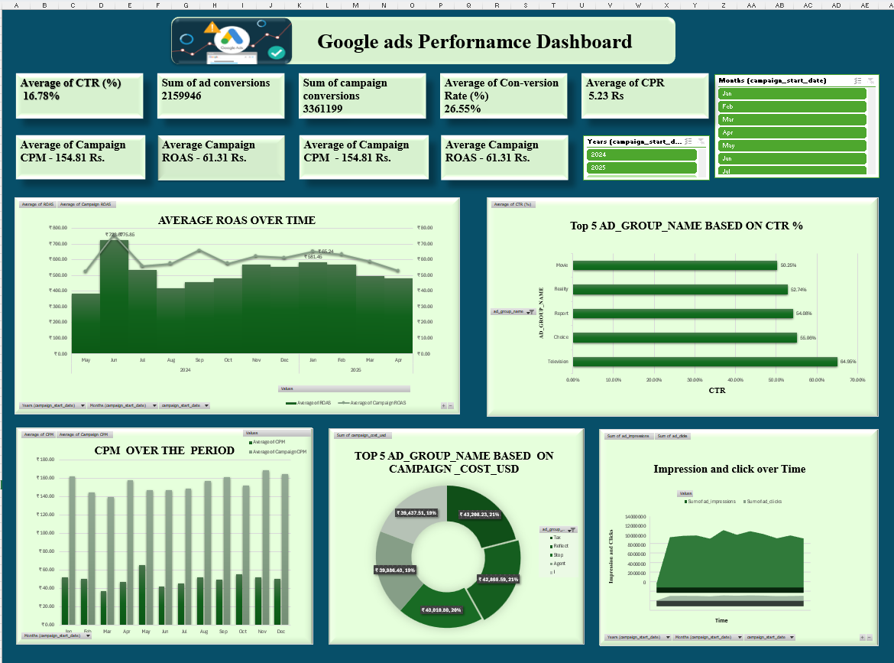

Slide 19
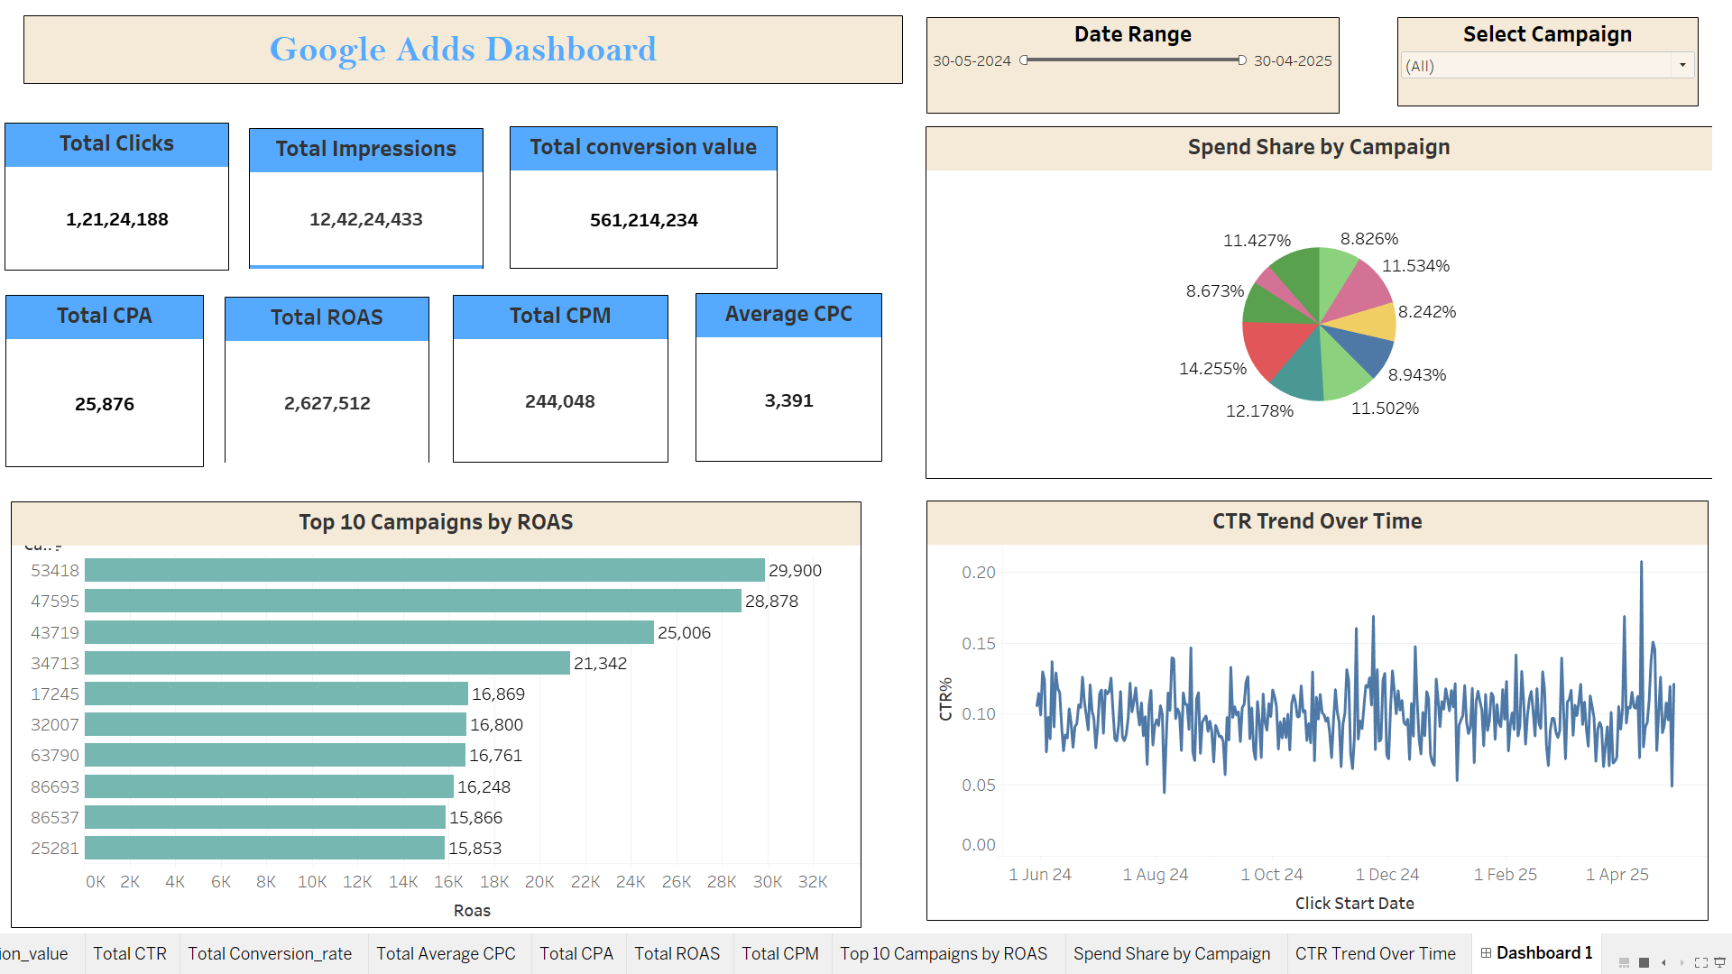

Slide 20
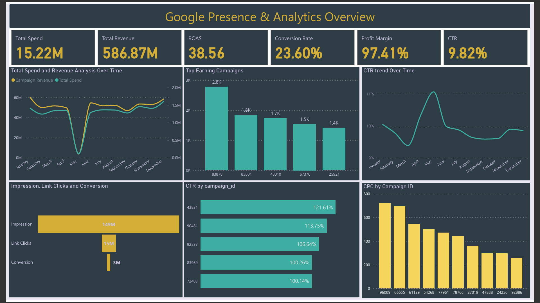

Slide 21
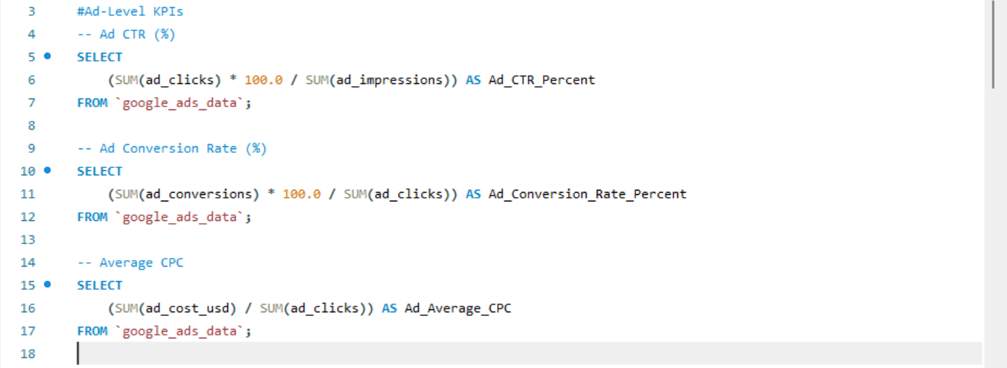
MySQL QnA for Google Analytics KPIs

Slide 22
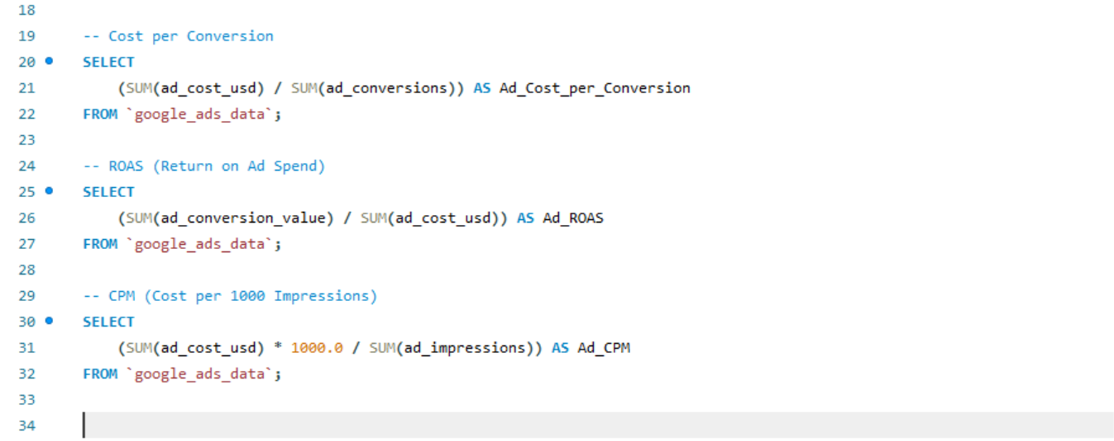

Slide 23
Google – Data Insights
Total Spend: Approx ₹15.22 million (Power BI).
Revenue: ₹586.87 million reported in BI dashboard.
CTR: Ranged from 9.82% (Power BI) to 16.78% (Excel).
Clicks: Over 12–15 million across reports.
Conversions: Over 3 million conversions (Power BI & Excel).
Conversion Rate: Around 23–26.5%.
ROAS: 38.56 (Power BI).
Profit Margin: 97.41% (Power BI).

Slide 24

More Insights
Top Campaigns: Search and retargeting campaigns drove most conversions.
Low CPA: Despite high spend, cost per conversion remained low.
Landing Page Impact: Better engagement (lower bounce rate) on ad-linked pages.
Seasonality: Clear performance spike in December, matching holiday season.

Slide 25
Google – Summary & Conclusion
Google ads brought strong traffic and high returns, especially in search campaigns.
High CTR and conversion rate helped drive better ROI.
Retargeting, keyword optimization, and landing page quality made a big difference.
Suggestion: Continue with keyword-based ads, use smart bidding, and keep testing.

Slide 26

Final Thoughts
Both platforms provide valuable reach and outcomes when used strategically.
Facebook is good for reach and awareness; performance improves with better targeting whereas Google is highly effective for conversions and return on investment.
Continued data-driven optimization of campaign structure, creatives, and audience segmentation will maximize ROI.
Regular performance audits and testing should guide future strategy and investment decisions.

Slide 27

We hope everything was clear and insightful. Happy to take any quick questions!

Slide 28

“Let’s transform data into insights and insights into meaningful impact!”
Thank you!

